Slide 1
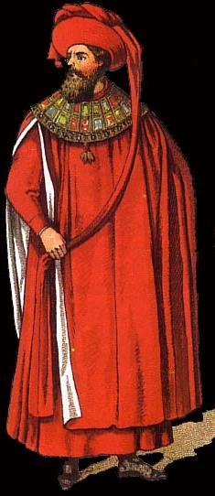
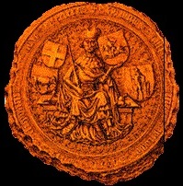
East European Heraldry
in Canada

Slide 2
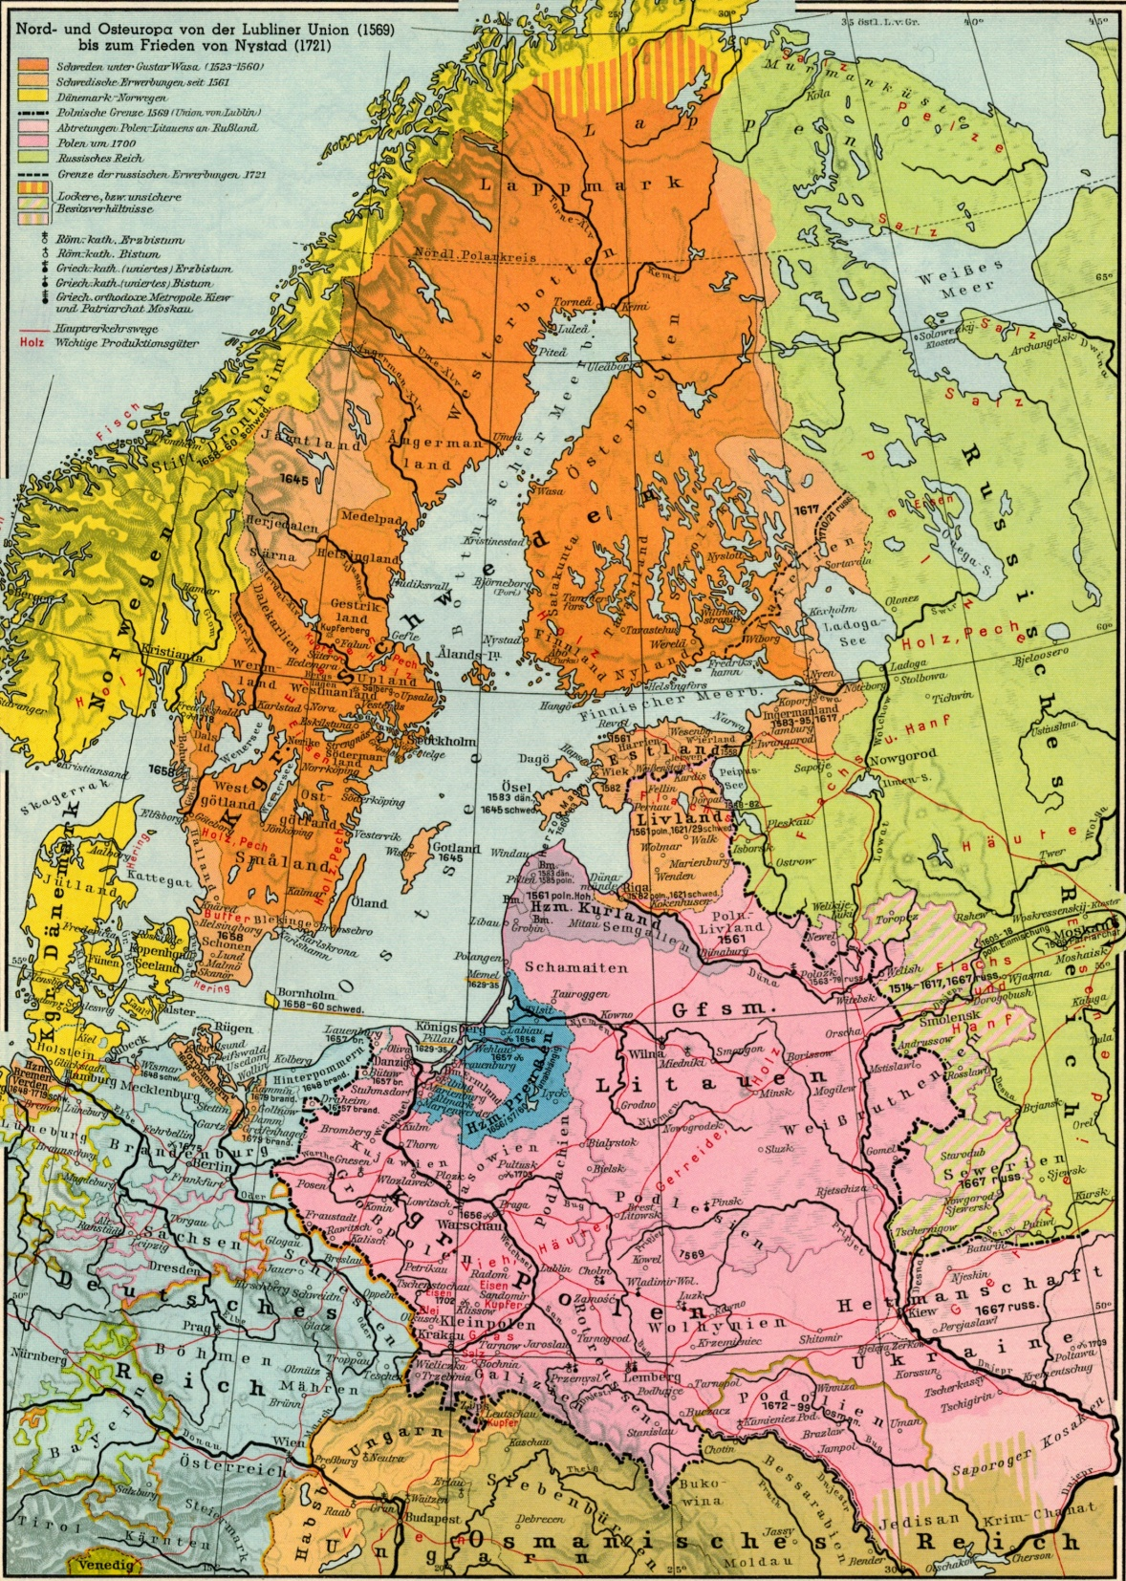

Slide 3
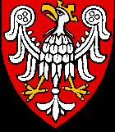
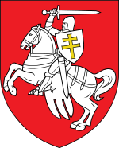
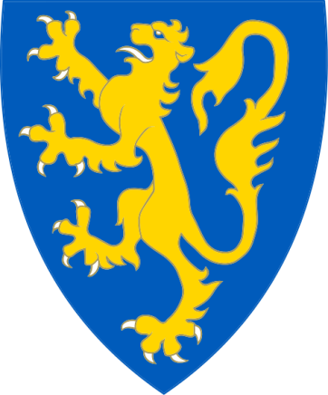
Poland, Pithuania & Ukraine

Slide 4
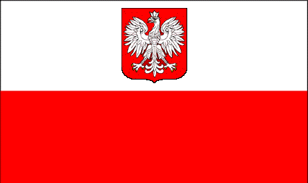
Poles
Total: 1, 010, 705 (by ancestry, 2011 Census)

Slide 5
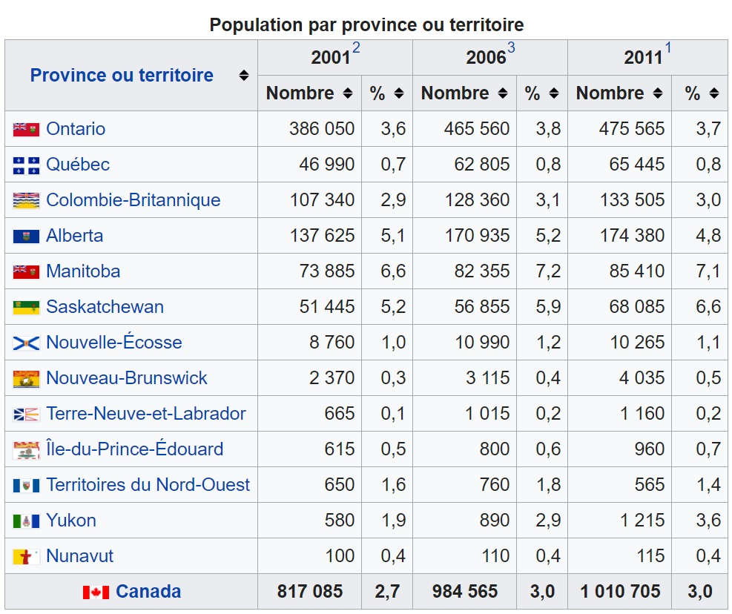

Slide 6
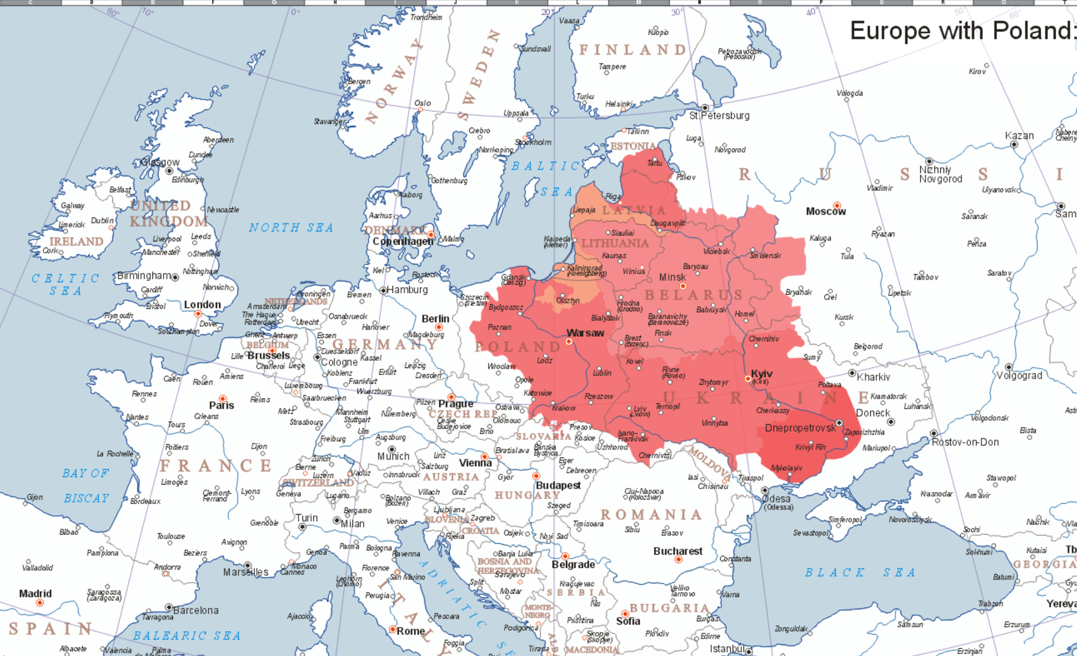

Slide 7
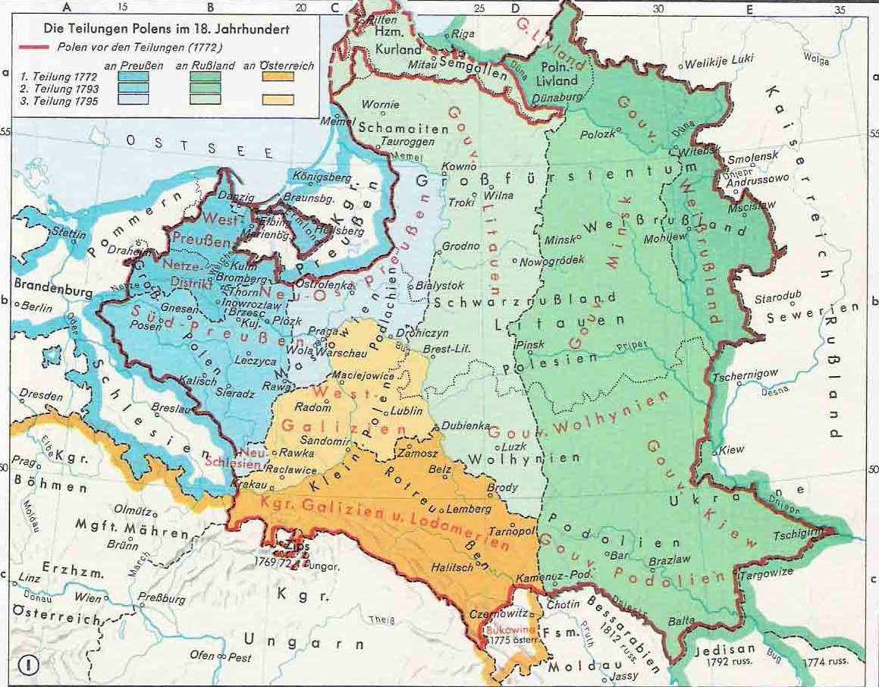

Slide 8
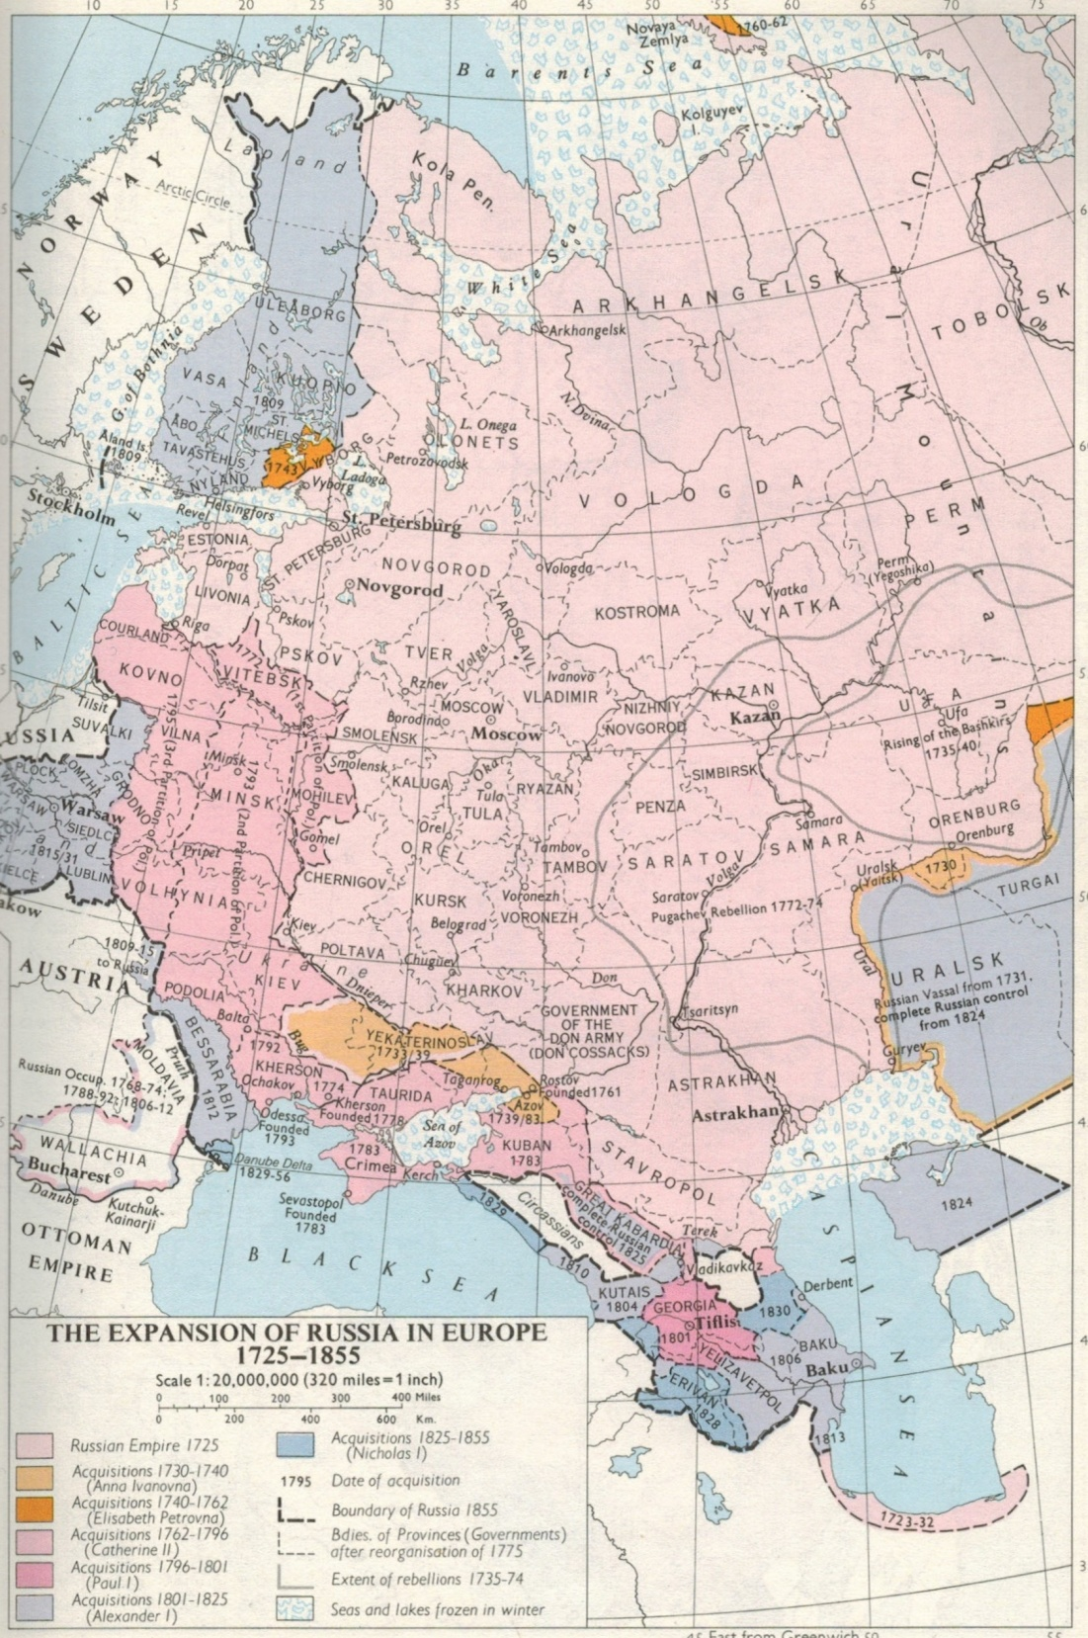

Slide 9
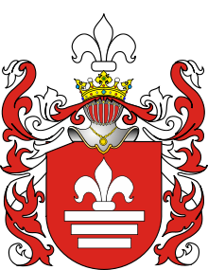
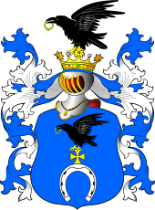
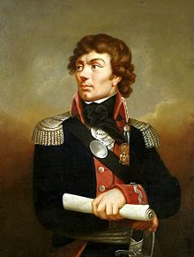
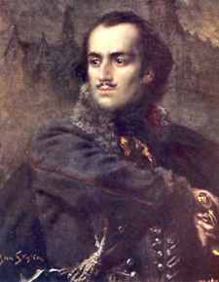
Slepowron
Roch
Kazimierz Pułaski
Tadeusz Kościuszko

Slide 10
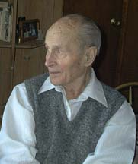
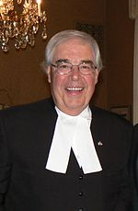
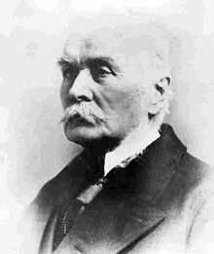
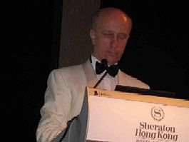
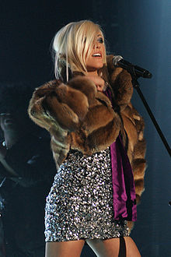
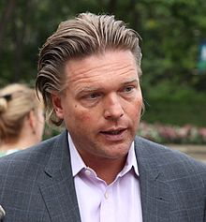
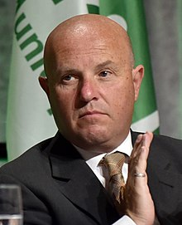
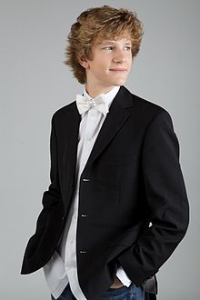
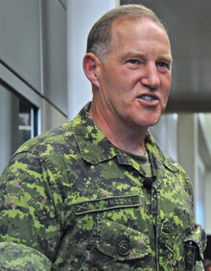
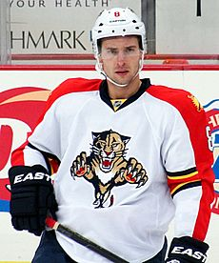
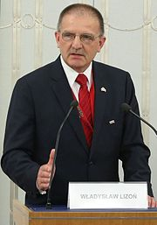

Slide 11
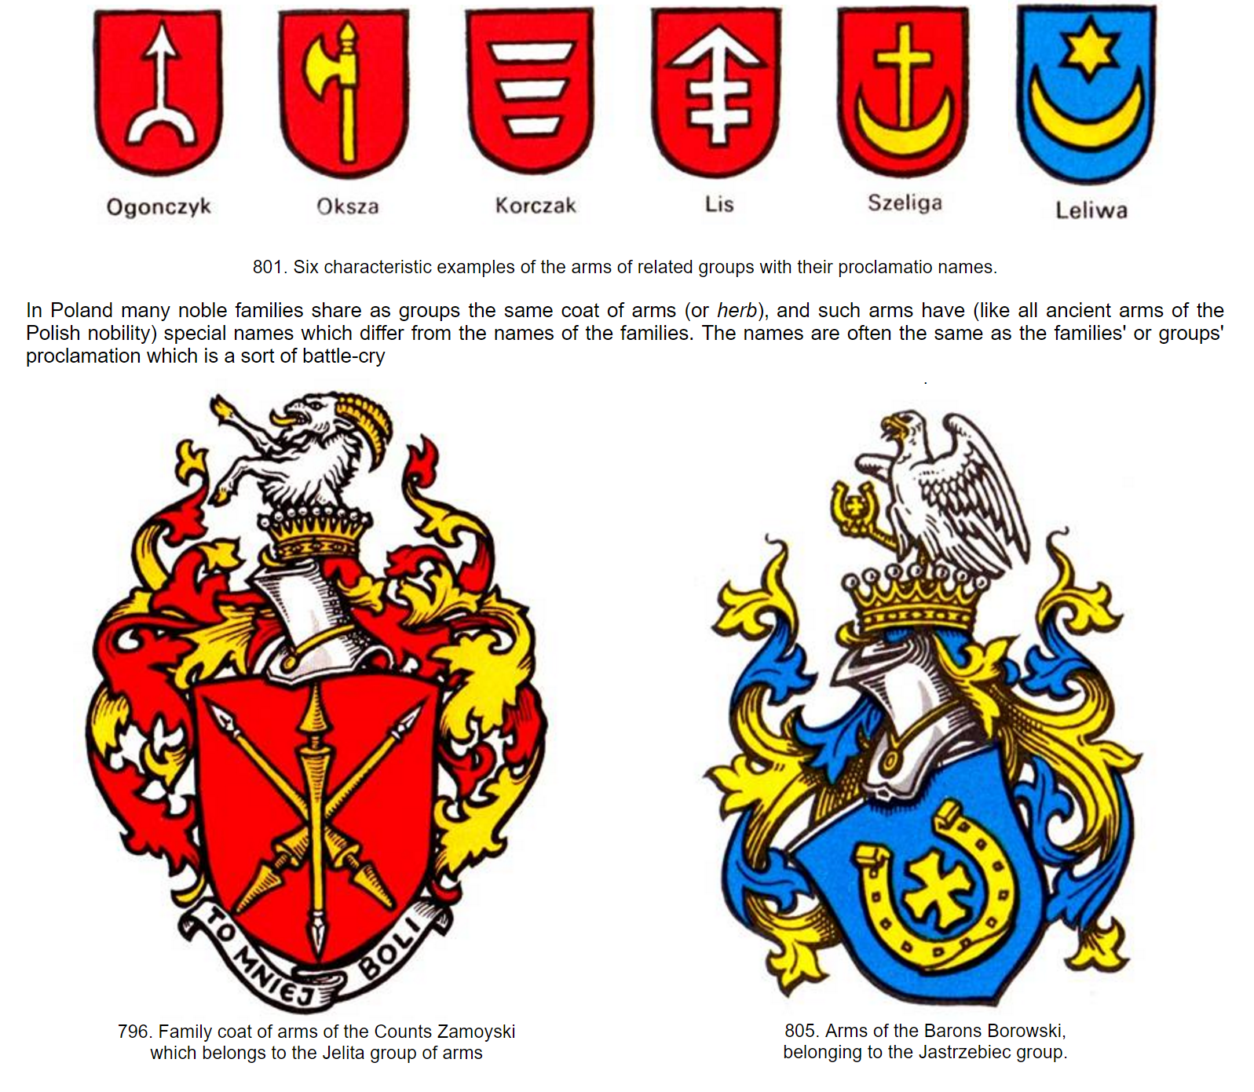

Slide 12
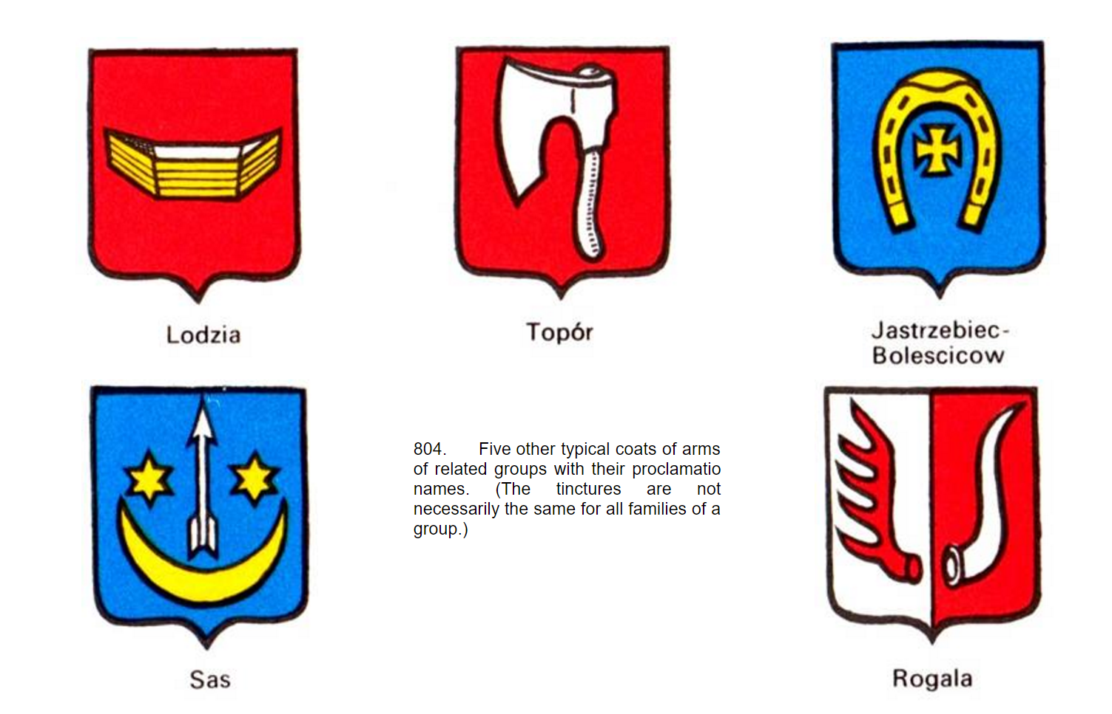

Slide 13
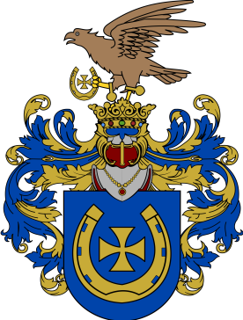
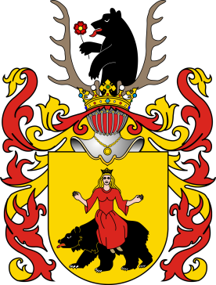
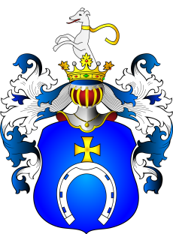
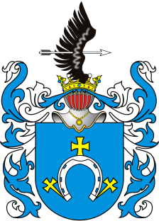
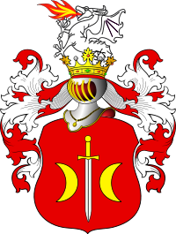
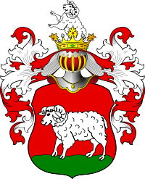
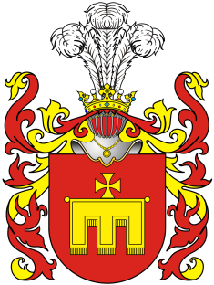
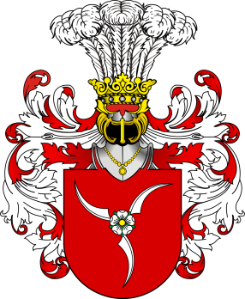
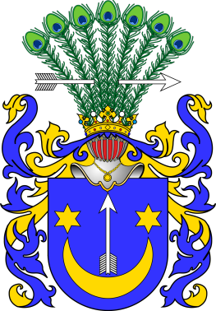
Polish Canadian recipients of the Order of Canada
Mary Adamowska Panaro, C.M. Winnipeg JASTRZEBIEC
Dr. Henry Wojcicki – Edmonton, distinguished psychiatrist RAWICZ
Polish Canadian Queen’s Counsels and lawyers appointed as judges Their Honors
Judge Paul Staniszewski – of Toronto, Montreal and the County Court of Windsor POBOG
Judge Allan H. J. Wachowich – of the Court of Queen’s Bench in Edmonton DABROWA
Science and engineering
Casimir Gzowski – engineer who worked on Welland Canal, New York & Erie Railway
(first Commissioner of the Niagara Parks Commission) JUNOSZA
Karol Józef Krótki, FRSC – demography professor, statistician RADWAN
Witold Rybczynski – architect, professor and writer JASTRZEBIEC
Lucas Skoczkowski – founder and CEO of Redknee JUNOSZA
Adam Skorek – professor of electrical and computer engineering ROLA
Nicole Tomczak-Jaegermann, FRSC – mathematics professor PRZEGONIA
Janusz Żurakowski – Battle of Britain fighter pilot SAS

Slide 14
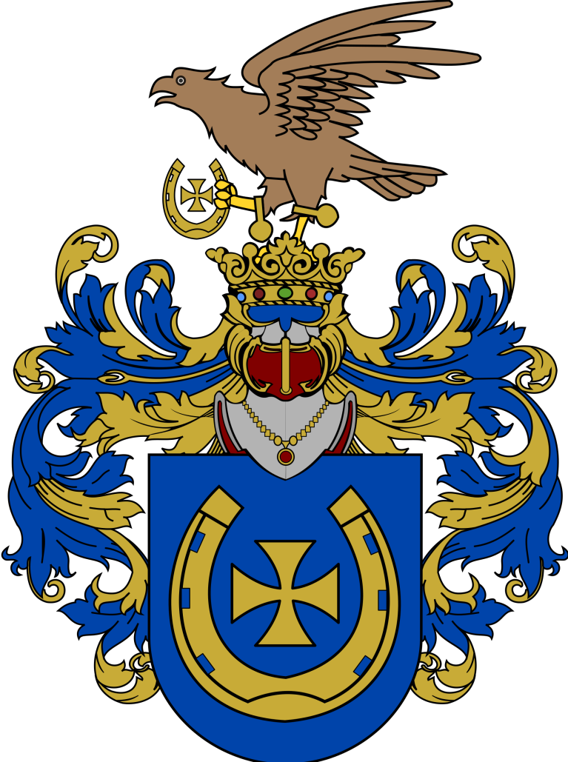
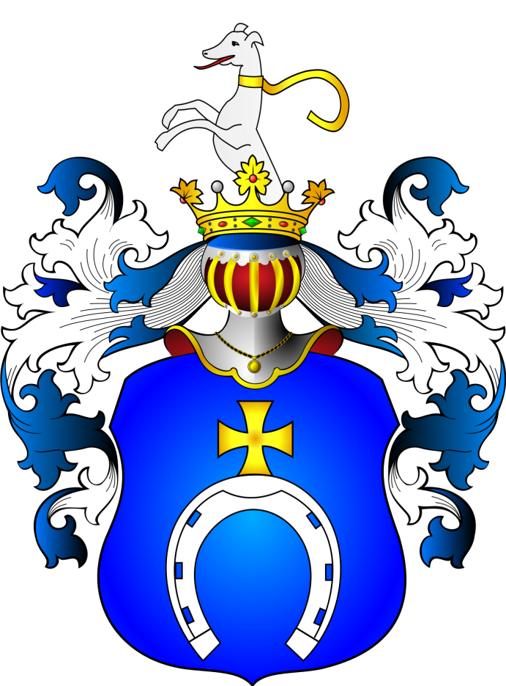


Slide 15
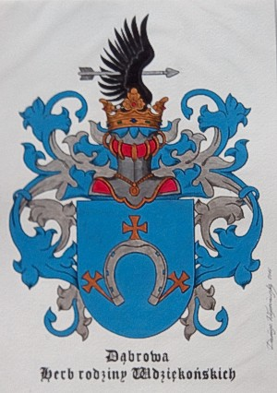
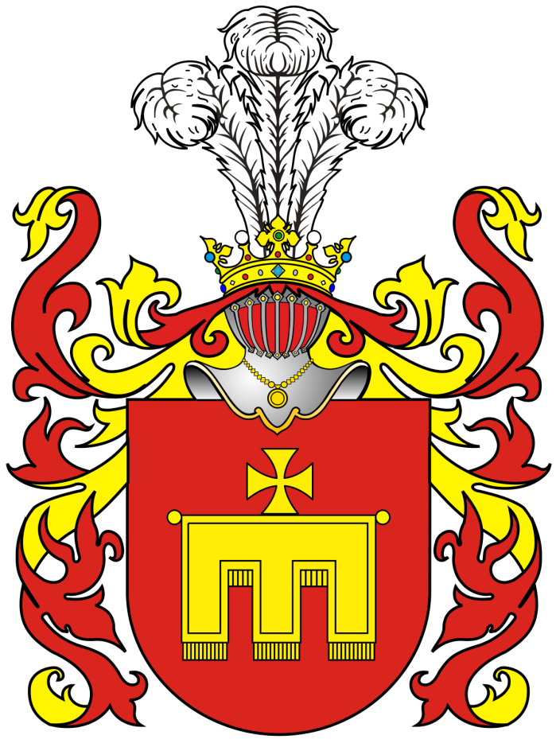
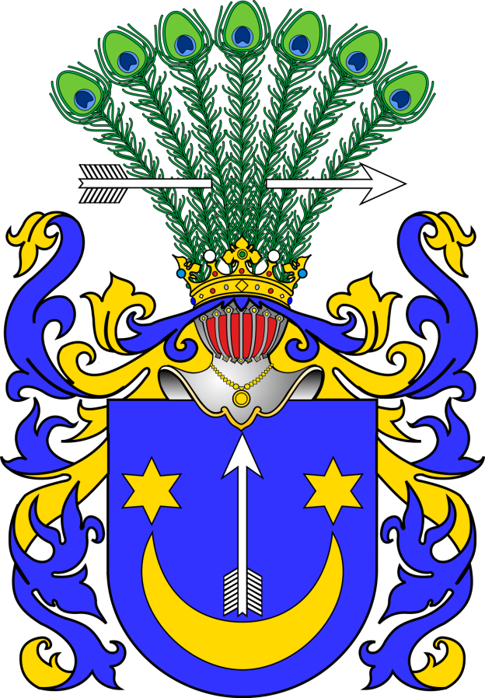
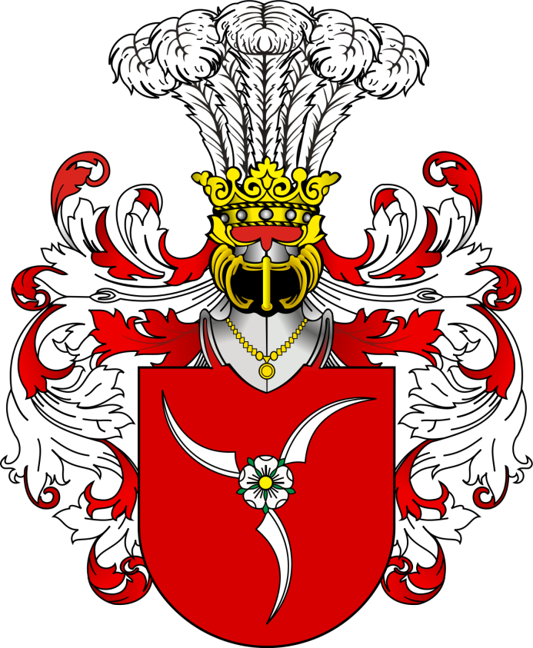

Slide 16
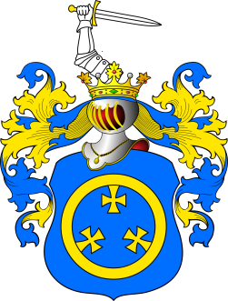

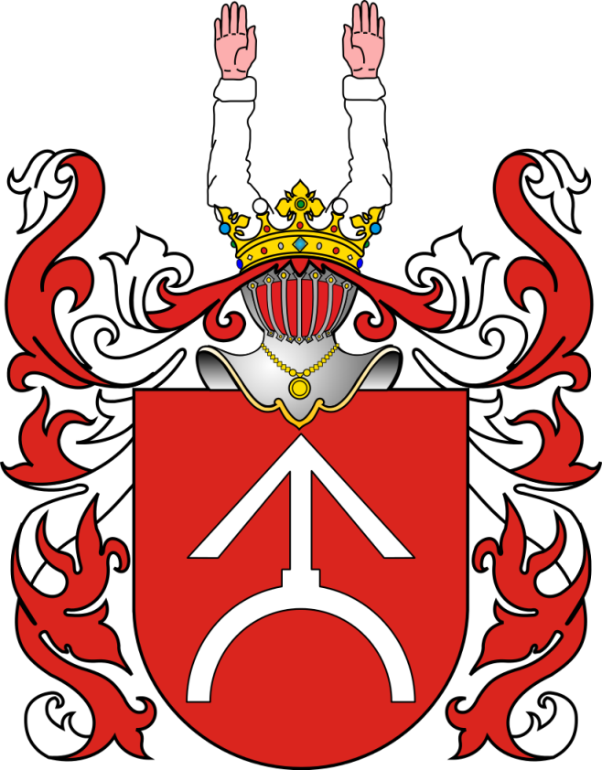
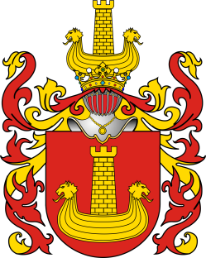
Politics
Jan Dukszta – former Ontario NDP MPP, Parkdale (1971–1981) ROCH
Andrew Kania – former Liberal Member of Parliament for Brampton West (2008–2011) RADWAN
Alexandre-Édouard Kierzkowski – former Liberal MP St. Hyacinthe (1867–1870), First MP of Polish Descent JASTRZEBIEC
Chris Korwin-Kuczynski – former Toronto city councillor (1981–2003) KORWIN-KUCZYNSKI
Ken Kowalski – former Deputy Premier of Alberta (1992-1994), former Alberta Government Minister, Speaker of the Legislative Assembly of Alberta (1997-2012), KORAB
Ted Opitz – former Conservative MP for Etobicoke Centre (2011-2015) OGONCZYK
John Yakabuski – Ontario Progressive Conservative MPP Renfrew—Nipissing—Pembroke (2003–present), son of Paul Yakabuski JASTRZEBIEC
Paul Yakabuski – former Ontario Progressive Conservative MPP, (1963-1987), father of John Yakabuski
Ed Ziemba – former Ontario NDP MPP, High Park—Swansea (1975–1981), brother-in-law of Elaine Ziemba OGONCZYK
Elaine Ziemba – former Ontario NDP MPP, High Park—Swansea (1990–1995), sister-in-law of Ed Ziemba

Slide 17
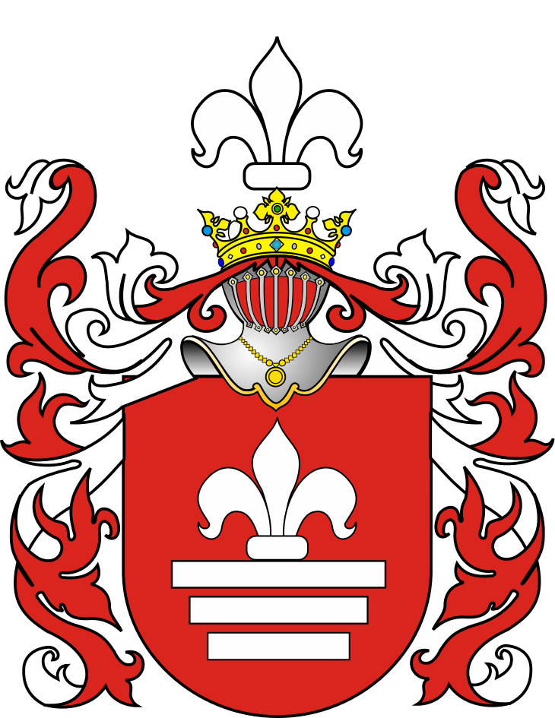
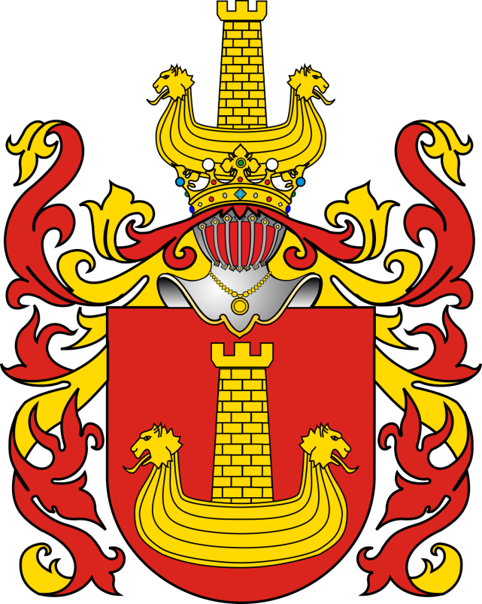
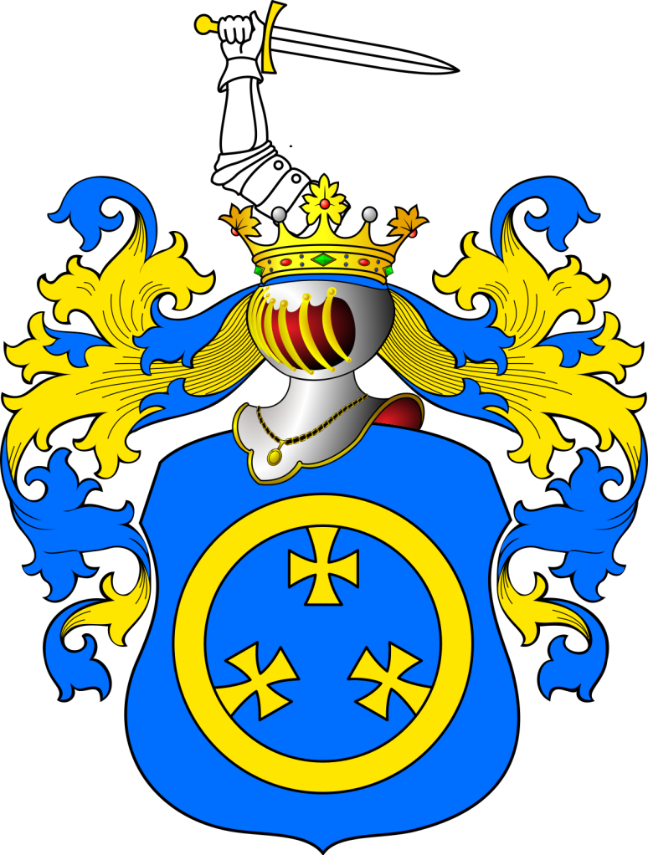

Slide 18
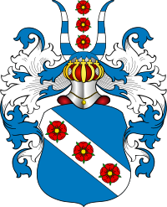





Music
Dan Bryk – singer-songwriter DOLIWA
Walter Buczynski – composer RADWAN
Basia Bulat – singer-songwriter OGONCZYK
Janina Fialkowska – pianist, born in Montreal SLEPOWRON
Marek Jablonski – pianist-virtuoso, born in Cracow BONCZA
Steve Jocz – drummer for Sum 41 GODZIEMBA
Jan Lisiecki – pianist-virtuoso, born in Calgary LELIWA
Kinga Mitrowska – singer RAWICZ
Jacob Kuba Rybicki – music producer, born in Toronto SLIEPOWRON
Culture and media
Bogdan Czaykowski – poet, translator, essayist JASTRZEBIEC
Anne Mroczkowski – journalist, news anchor NALECZ
Estanislao (Stan) Oziewicz - journalist, The Globe and Mail LUBICZ
George Radwanski – editor-in-chief of the Toronto Star LELIWA

Slide 19




Slide 20





Actors
Lara Jean Chorostecki – actress LUBICZ
Henry Czerny – actor NOWINA
Paloma Kwiatkowski – actress LELIWA
Lisa Ray – actress JELITA
Sports
Peter Czerwinski – competitive eater and bodybuilder LUBICZ
Gabriela Dabrowski – professional tennis player JASTRZEBIEC
Michael Klukowski – soccer player for Club Brugge GOZDAWA
Walter "Killer" Kowalski – professional wrestler ABDANK
Joe Krol – Toronto Argonauts player JASTRZEBIEC
Tomasz Kucharzewski – martial artist GODZIEMBA
Tomasz Radzinski – soccer player JASTRZEBIEC
Krzysztof Soszynski – mixed martial artist KRZYWDA
Wojtek Wolski – player NHL RAWICZ

Slide 21





Slide 22


Lucky
Sas

Slide 23

Magnusky
Abdank

Slide 24


Mikhin
Rola

Slide 25


Zebrowski
Jasienczyk

Slide 26

Ukrainians
1,251,170 (by ancestry, 2011 Census)

Slide 27

Settlement – first wave (1891–1914)

Slide 28


Slide 29






Notes:
Randy Bachman, Eugene Melnyk, Ray Hnatyshyn, Daria Werbowy, Sylvia O. Fedoruk, Wayne Gretzky and 1 209 085 more…

Slide 30


Slide 31



Slide 32
Ramon John Hnatyshyn PC CC CMM CD QC (Can) QC (Sask) FRHSC(hon)
(March 16, 1934 – December 18, 2002),
commonly known as Ray Hnatyshyn, was a Canadian politician and statesman who served as Governor General of Canada, the 24th since Canadian Confederation.

Slide 33





Slide 34
Kingdom of Galicia – Wolhynia
1199 - 1349

Slide 35



King Daniel of Ruthenia 1253-1264
King Leo I of Ruthenia
1269 - 1301
King Vasilko of Ruthenia
1264 - 1269

Slide 36



King Yuri of Ruthenia 1301-1308
King Andriy of Ruthenia 1315 - 1323

Slide 37



Slide 38
Magnusky
Abdank

Slide 39

Russians
According to the 2011 Census, there were 550,520 Canadians
who claimed full or partial Russian ancestry.

Slide 40









Slide 41

Bluma Appel - philanthropist, recipient of the Order of Canada and Order of Ontario
Grand Duchess Olga Alexandrovna of Russia - Russian Princess and youngest sister of Tsar Nicholas II of Russia
Alex Atamanenko - Member of Parliament in the House of Commons of Canada
Vasile Balabanov - Imperial Russian émigré
Catherine Doherty - Imperial Russian émigré, social activist, recipient of the Order of Canada
Siegfried Enns - member of the Canadian House of Commons
Lois Hole - Lieutenant Governor of Alberta
George Ignatieff - Canadian diplomat
Michael Ignatieff - author, journalist, academic, politician
Peter Vasilevich Verigin - Doukhobor leader
Pyotr Verzilov - activist
Gregory Chamitoff - NASA astronaut and engineer
George Volkoff, OC, MBE, FRSC - physicist who helped discover the existence of neutron stars
Ivan Babikov - Olympic cross-country skier
Patricia Bezzoubenko - rhythmic gymnast
Andrei Markov - NHL hockey player

Slide 42


Slide 43




Slide 44


Slide 45


Slide 46


Slide 47


Slide 48


Slide 49

Grand Duchess Olga

Slide 50

Prince Golitsyn

Slide 51


Slide 52


Slide 53



Slide 54
Mikhin
Rola

Slide 55



Slide 56


Slide 57


Slide 58


Slide 60

Baltic Germans
Many thousands of Baltic Germans emigrated to Canada starting in 1948 with the support of Canadian Governor General The Earl Alexander of Tunis, who had known many Baltic Germans when he had fought against the Baltic German Landeswehr for a short time in 1919. Initially only 12 Germans were allowed to settle in 1948. Based on the good behavior of this group, many thousands of Baltic Germans were soon allowed to immigrate during the following years.

Slide 61

Earl Alexander of Tunis

Slide 62



Slide 63


Slide 65


The Duchy of Kurland

Slide 66


Jacob von Kettler
(28 October 1610 – 1 January 1682) was a Baltic German Duke of the Duchy of Courland and Semigallia (1642–1682). Under his rule, the duchy reached its peak in wealth and engaged in colonization.

Slide 67


Slide 68


Ernst von Biron
Kristoph von Münnich

Slide 69


von Biron
von Hahn

Slide 70

von Boetticher

Slide 71



Wrangel

Slide 72

Finns
136,215 (by ancestry, 2011 Census)
0.4% of the Canadian population

Slide 73

The earliest Finnish immigrants to Canada came from the US, possibly as early as 1820's for the construction of the Welland Canal. The Canadian Pacific Railway recruited immigrants directly from Finland in the late 1800s

Slide 74









Slide 75




Notable Finnish Canadians
Pamela Anderson, actress
Judy Erola, politician and businesswoman
Stuart Immonen, comic book and sketch artist
Pentti Lund, National Hockey League player
Michael Mahonen, actor
Chico Maki, ice hockey player
Kate Maki, singer-songwriter
Wayne Maki, ice hockey player
Sarah Manninen, actress
Peter Nygård, founder and CEO of Nygård International
Kalervo Oberg, anthropologist
Chris Pronger, National Hockey League player
Sonya Salomaa, actress and model
Ray Timgren, National Hockey League player
Tyler Varga, NFL player
Jake Virtanen, ice hockey player

Slide 76

Nygård

Slide 77
Lund

Slide 78


Slide 80

Georgians
The Georgian community in Canada is a total of 3,155 based on the Canadian Census 2011. Most Georgian-Canadians reside in larger metropolitan areas across the country.

Slide 81


Slide 82




Slide 83


Slide 84






Slide 85



Slide 86




Slide 87



Crown Prince Michael Imeretinsky

Slide 88


Prince Konstantin Abkhazi

Slide 89


Slide 90
Heraldic Artists

Slide 91


Slide 92

Michael Medvedev

Slide 93
Alexander Kurow

Slide 94


Slide 95


Steve Cowan

Slide 96


